Slide 1

AI PHISHING BLOCKER
by
WHITE HATS
Domain: Fin Tech
Karpagam Academy of Higher Education

Slide 2

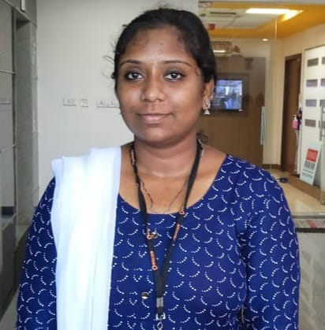
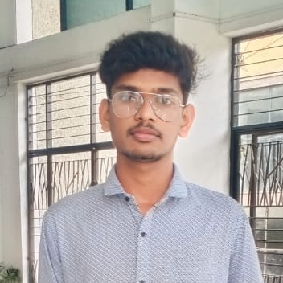
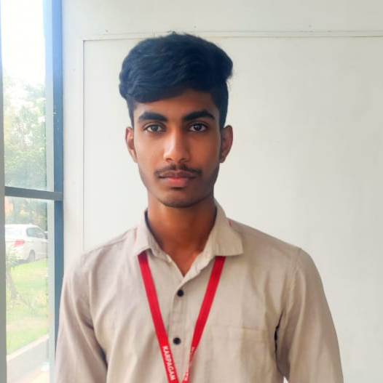
02
RANJANI P
MADHUSHREE S
“One of the member in White Hats and currently pursuing a BE in Computer Science and Design at Karpagam Academy of Higher Education.”
“One of the member in White Hats and currently pursuing a BE in Computer Science and Design at Karpagam Academy of Higher Education.”
Team Members
CHANDRAKANTH K S
MADHANPRASATH D
“One of the member in White Hats and currently pursuing a BE in Computer Science and Design at Karpagam Academy of Higher Education.”
“Team Lead of White Hats and currently pursuing a BE in Computer Science and Design at Karpagam Academy of Higher Education.”

Slide 3

04
Problem Statement
Phishing Scam Statistics
76% of companies fell victim to phishing scams in 2021
An average of 1.4 million phishing sites are created every month.
Phishing -target groups of people
Younger workers are five times more likely to make mistakes that result in security issues.
43% of people have compromised their work’s cyber security while working.
Phishing attacks are a major issue. These scams motivate consumers to divulge their personal information, including passwords and credit card details. These tricks continue to work even though we are aware of them and people continue to fall for them.
In this unsecured environment, The financial and more sensitive data are take over by the scammers. It leads to loss of money and essential data.

Slide 4

05
Innovative Solution
The proposed solution focuses on enhancing fraud detection through the development of a browser extension aimed at detecting phishing websites.
Leveraging the power of Generative Adversarial Networks (GANs), synthetic phishing URLs can be generated to create a diverse dataset of closely-identical websites.
This dataset can be utilized to train and strengthen the machine learning classifier, improving its accuracy in distinguishing legitimate websites from fraudulent ones.
When a user visits a website, the browser extension will analyse the URL and provide real-time notifications by Blocking the webpage, clearly indicating whether the website is genuine or a phishing site.
By utilizing this innovative approach, users can trust that their sensitive information is safeguarded, ensuring a safer online experience and reducing the risk of falling victim to cybercriminals.

Slide 5
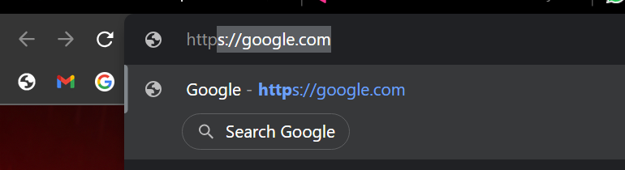




06
Idea Work Flow
Phishing URL’s
Training
Dataset
Legitimate URL’s
Input
Taken from Search bar at the time of webpage rendering
Repeating the process for the every URL
The Dataset generated by the GAN
Legitimate
The Machine Learning model can predict he given URL is genuine or not
If the website is genuine the allow user to access the website
Generative Adversarial Network (GAN)
to produce synthetic phishing URLs can be generated to create a diverse dataset of closely-identical websites.
Block
If the website is genuine the not allow user to access the website

Slide 6

07
Modules
URL Parsing
Generative Adversarial Network
Classification
Algorithm
IT is the module that can used to fetch the data from the URL, The URL Parsing plays the key role in our project.
The Generative Adversarial Network is used to replicate the data URL in the dataset. The data created by the GAN are Identical or Closely Identical to the real data
The Machine Learning Algorithm are used to classify the result based of the dataset which is created by GAN
These are the major modules we used to create the this project

Slide 7
07
Technology Stack
We use Python as our core programming language and HTML, CSS, Java Script for Extension
URL Parsing
Generative Adversarial Network
Classification
Algorithm
URLlib
Request
TensorFlow
Keres
Pandas
NumPy
Matplotlib
sklearn

Slide 8

08
Our advanced technology-powered innovation drives progress by tackling a major issue in internet security. It uses machine learning for the detection and avoidance of phishing websites, protecting users from cyber threats.
In traditional phishing detection systems might be slow and inaccurate. There is a basic Firewall that is incapable of detecting threads through the internet.
Our technology transforms this procedure by parsing website URLs in real time and determining their validity. This quick decision-making reduces the possibility of people falling victim to phishing attacks.
Furthermore, our technology constantly adapts to evolving phishing techniques, allowing us to stay one step ahead of scam artists. It uses AI to learn from massive datasets which is generated by GAN, ensuring its capacity to detect even the most complex phishing attempts.
We enable users and organizations to access the internet securely by integrating our innovation into web browsers, enabling a safer online environment. This technologically driven strategy not only improves user protection but also saves lose of sensitive data like credit/debit card details, Passwords etc...
In conclusion, The technology-driven innovation accelerates change by delivering immediate, accurate, and adaptable protection against phishing threats, making the digital world a safer place for all.
How does your innovation accelerate change with the power of Technology

Slide 9

09
Unique from other solutions in market
The project is unique because it uses Generative Adversarial Networks (GANs) to make fake phishing URLs that closely resemble real websites in order to combat online fraud, especially phishing. This synthetic dataset, which is continually changing and adapting, improves the machine learning classifier's capacity to recognize minute differences in websites that are fake.
This approach stands out because it has a characteristic that no other system has the capacity to predict new phishing websites. Additionally, it provides real-time user notifications, as well as Blocking the user, enabling users to identify between legitimate and phishing websites and assuring complete online security in the face of ever-evolving cyberthreats. The projects also identifies the recent threats of phishing website making it a sustainable and safe space in the long run.
The fake IDs created by fraudsters is increasing. So the uniqueness is the generation of possible closely identical web site address.
There is not an existing system that is similar to this model.

Slide 10
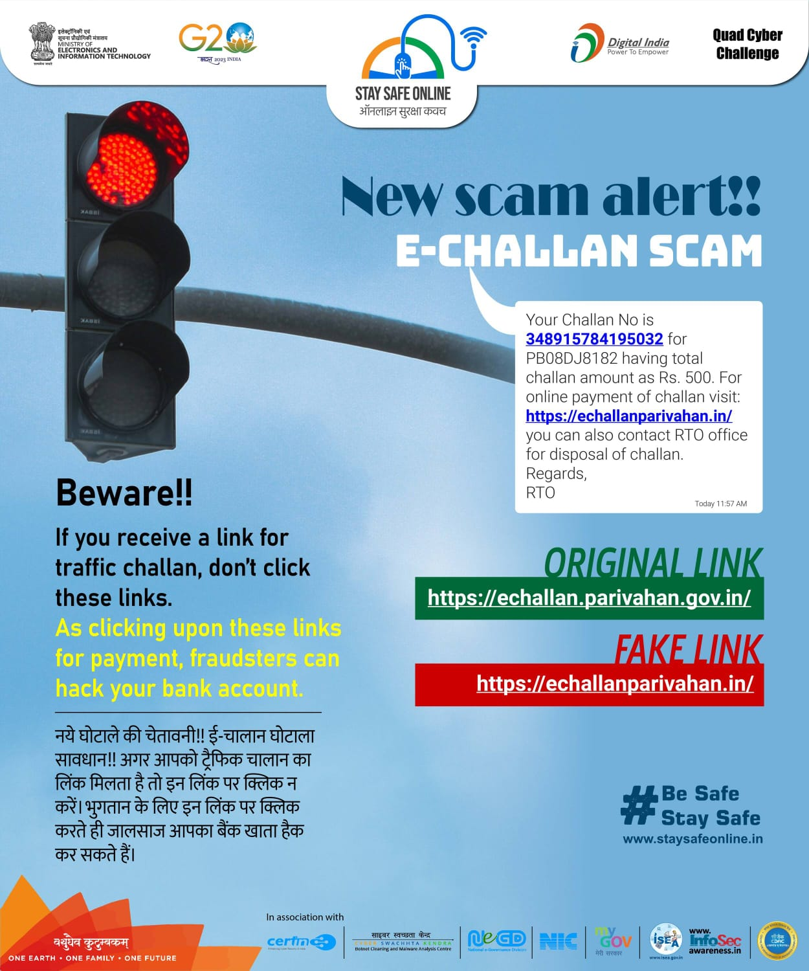
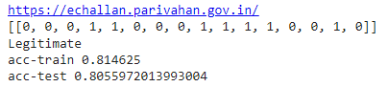
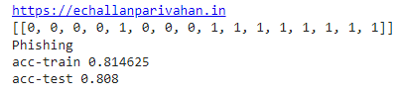
10
Recent Scam
In this scam the scammers send a text message to your phone that closely remembers e-challan alerts. The messages have a payment link. When the use click the link the device security is compromised, and the hackers get access to credit/debit card details. Before user know, Our model can also predict it.
Our Model Output

Slide 11


11
Market potential
If this project is implemented, phishing attacks will be reduced in the future.
This technology analyzes website requests in real time, recognizing and preventing phishing websites as they appear.
This proactive approach guarantees timely protection against new and developing threats, reducing the likelihood of becoming a victim of phishing attempts.

Slide 12

Thank You!

